Slide 1
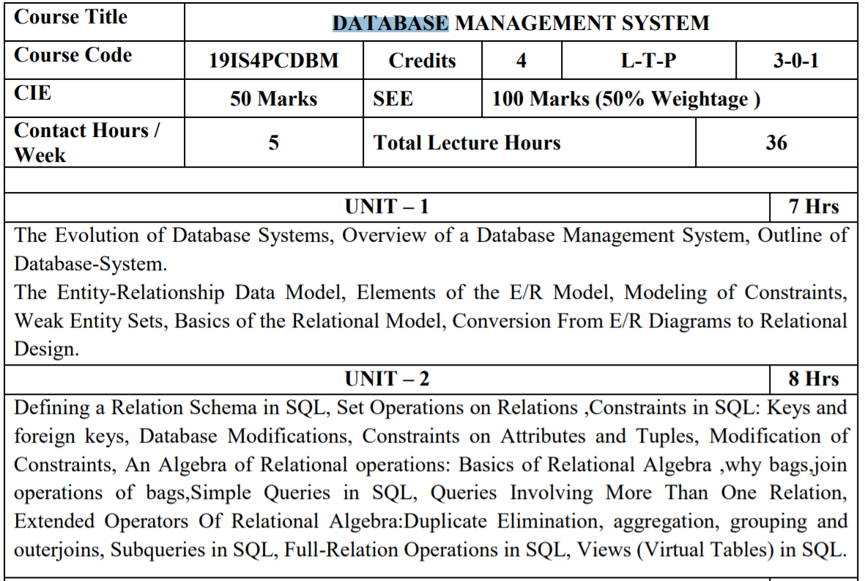
Database Management System

Slide 2
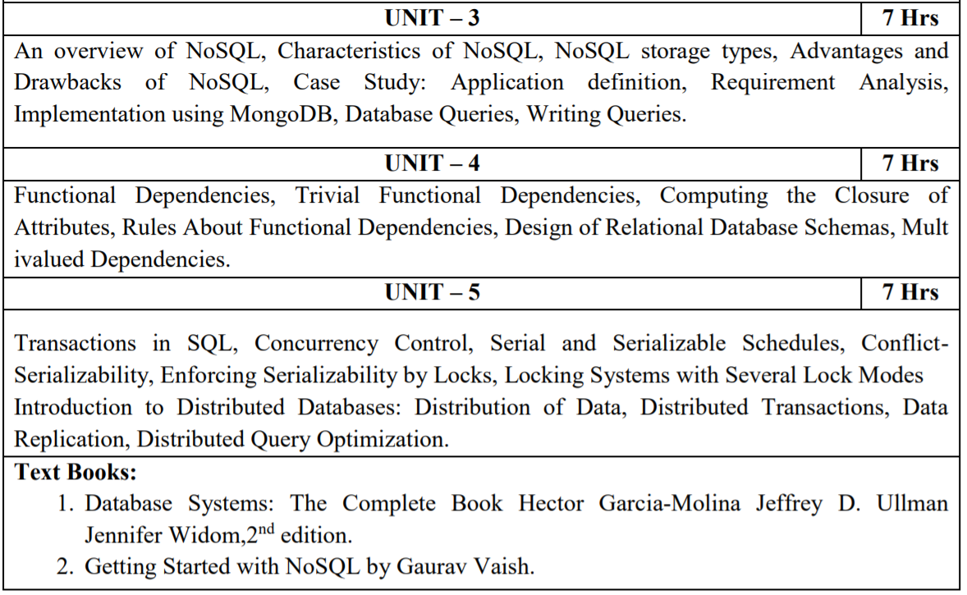
Database Management System

Slide 3
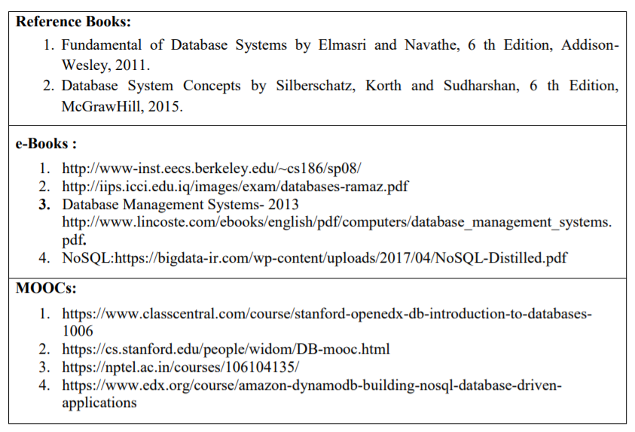
Database Management System

Slide 4
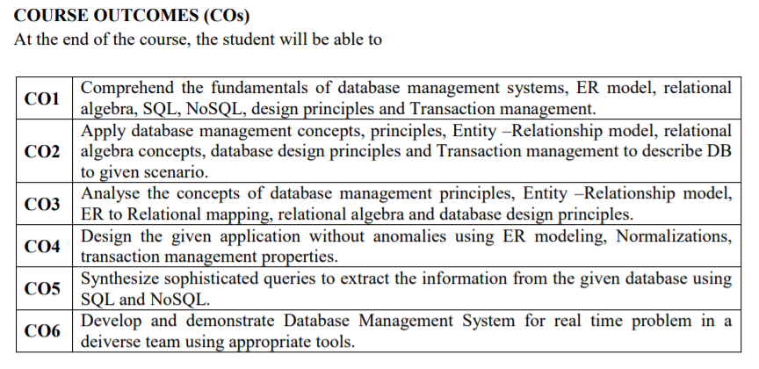
Database Management System

Slide 5
Introduction to DBMS
Data : Facts that can be recorded. Ex. Text, numbers, audio, video or images, etc.
Database : Collection of related data that represents real world entities. Ex. Employee, hospital database, etc.
Information : meaningful or processed data. We extract information from data.
DBMS : is a software tool to organize (create, retrieve, update, and manage) data in a database.
Database System : data and dbms.

Slide 6
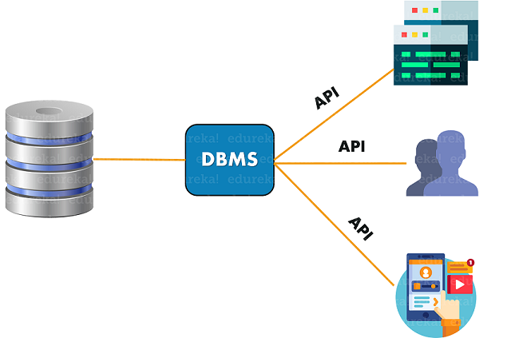
Database Management System
A Database Management System (DBMS) is a piece of software that manages databases and lets you create, edit and delete databases, their tables and their data. Examples of a DBMS are MySQL, Oracle, MS Access, etc

Slide 7
File System
File system is basically a way of arranging the files in a storage medium like hard disk.
File system organizes the files and helps in retrieval of files when they are required.
File systems consists of different files which are grouped into directories. The directories further contain other folders and files.
File system performs basic operations like management, file naming, giving access rules etc.

Slide 8
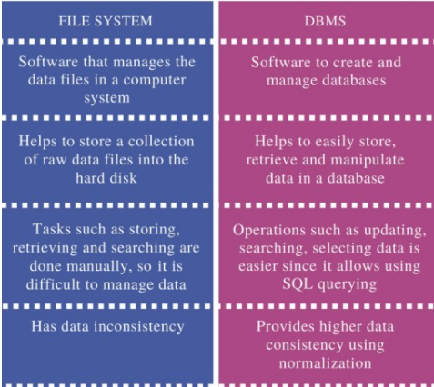
Difference between File System and DBMS

Slide 9

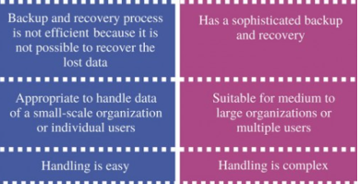
Difference between File System and DBMS

Slide 10
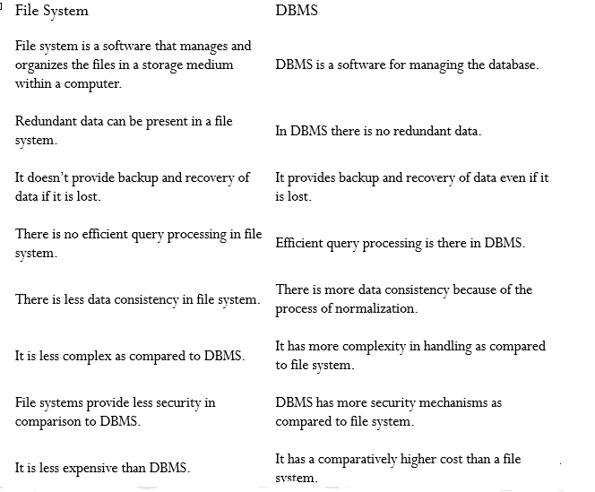
Difference between File System and DBMS

Slide 11
Types of DBMS
Hierarchical databases
Network databases
Relational databases
Object-oriented databases
Graph databases
ER model databases
Document databases
NoSQL databases

Slide 12
Hierarchical database model
Data is organized into a tree-like structure.
The data is stored in the form of a collection of fields where each field contains only one value.
The records are linked to each other via links into a parent-children relationship.
Each child record has only one parent. A parent can have multiple children.
To retrieve a field’s data, we need to traverse through each tree until the record is found.

Slide 13
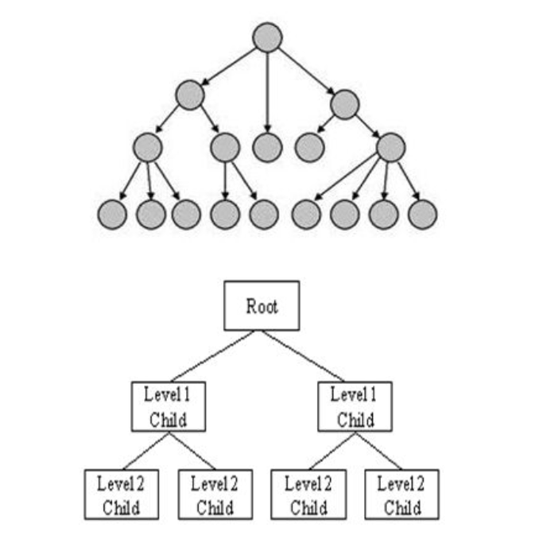
Hierarchical database model

Slide 14
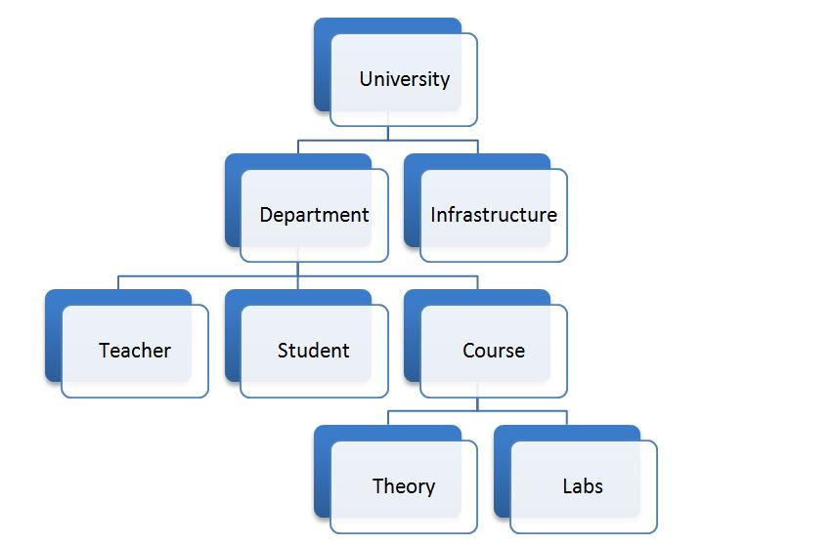
Hierarchical database model
Hierarchical database model:

Slide 15
Hierarchical database model
Advantage
A hierarchical database can be accessed and updated rapidly.
Disadvantage
This type of database structure is that each child in the tree may have only one parent.
Relationships or linkages between children are not permitted, even if they make sense from a logical standpoint.
Adding a new field or record requires that the entire database be redefined.

Slide 16
Network Database Model
Uses a network structure to create a relationship between entities.
Network databases are hierarchical databases, but unlike hierarchical databases where one node can have a single parent only, a network node can have a relationship with multiple entities.
In network databases, children are called members and parents are called occupiers.
The difference between each child or member is that it can have more than one parent.
Ability to handle many to many relationships

Slide 17
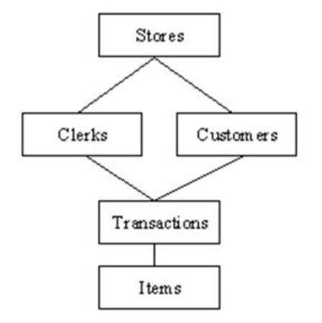
Network Database Model

Slide 18
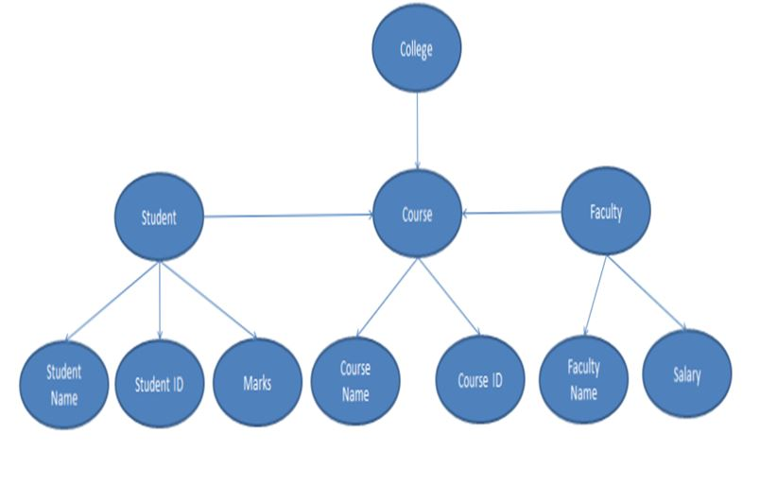
Network Database Model

Slide 19
Network Database Model
Advantage
The network model can support many to many relationships
Disadvantage
The network model is much more complicated than the Hierarchical model. As such, it is difficult to handle and maintain.
The structure of the Network Model is quite complicated and so the programmer has to understand it well in order to implement or modify it.

Slide 20
Relational Database Model (RDBMS)
The relationship between data is relational and data is stored in tabular form of columns and rows.
Each column of a table represents an attribute and each row in a table represents a record. Each field in a table represents a data value.
Structured Query Language (SQL) is the language used to query RDBMS, including inserting, updating, deleting, and searching records.
Relational databases work on each table that has a key field that uniquely indicates each row. These key fields can be used to connect one table of data to another.
Relational databases are the most popular and widely used databases. Some of the popular DDBMS are Oracle, SQL Server, MySQL, SQLite, and IBM DB2.

Slide 21
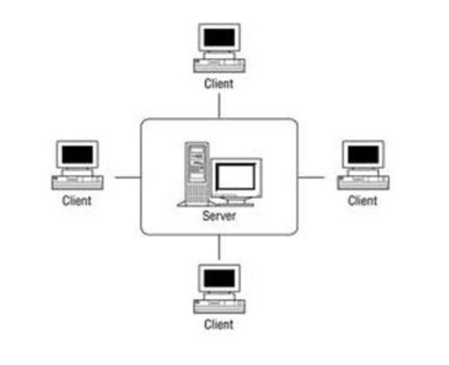
Relational Database Model (RDBMS)

Slide 22
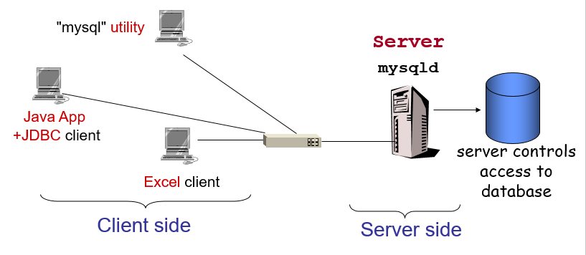
Client Server Database

Slide 23
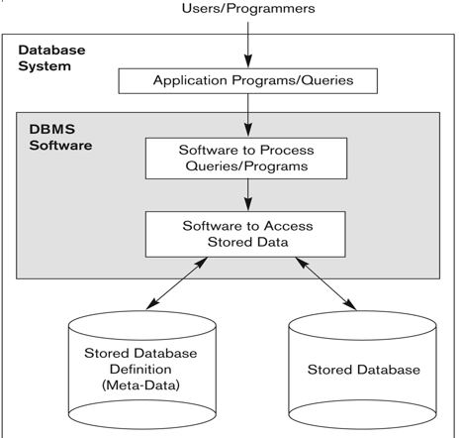
Simplified Database Environment

Slide 24
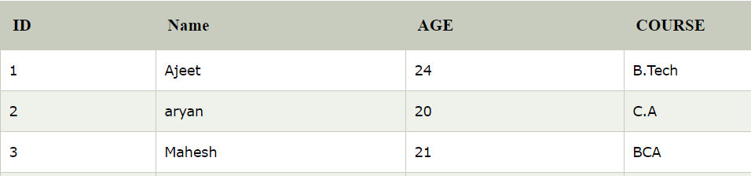
Relational Database Model (RDBMS)
The most popular type of DBMS are Relational Database Management Systems, or RDBMSs.
A Relational database management system (RDBMS) is a database management system (DBMS) that is based on the relational model as introduced by E. F. Codd.
Database consists of a structured set of tables and each row of a table is a record.
RDBMS : MySQL, Oracle, SQL Server, PostGreSQL, etc.

Slide 25
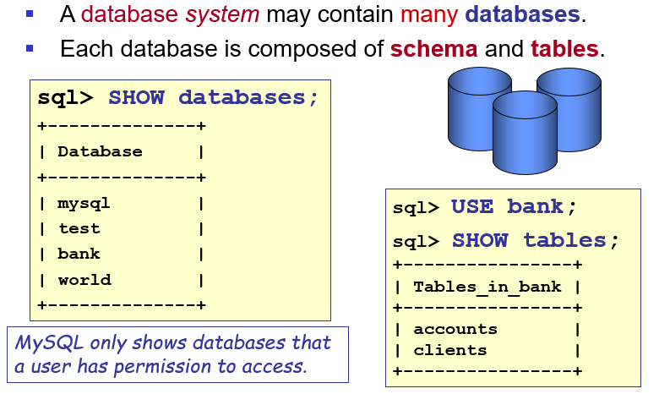
Structure of database

Slide 26
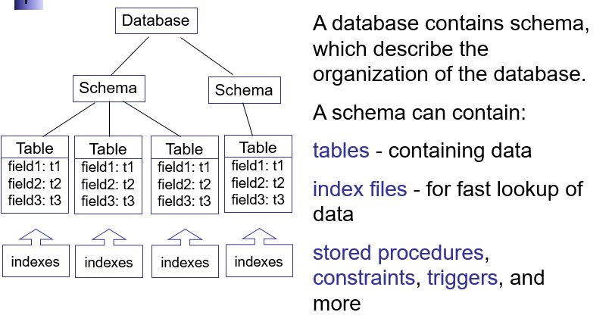
Structure of database

Slide 27
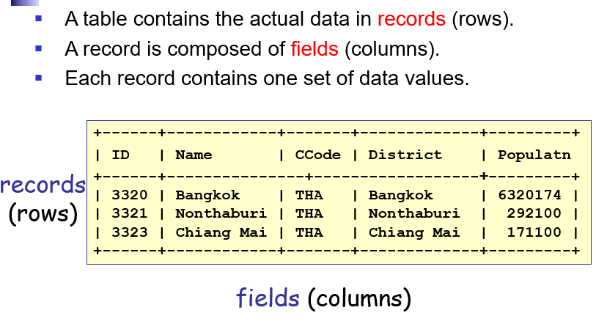
Contents of a table

Slide 28
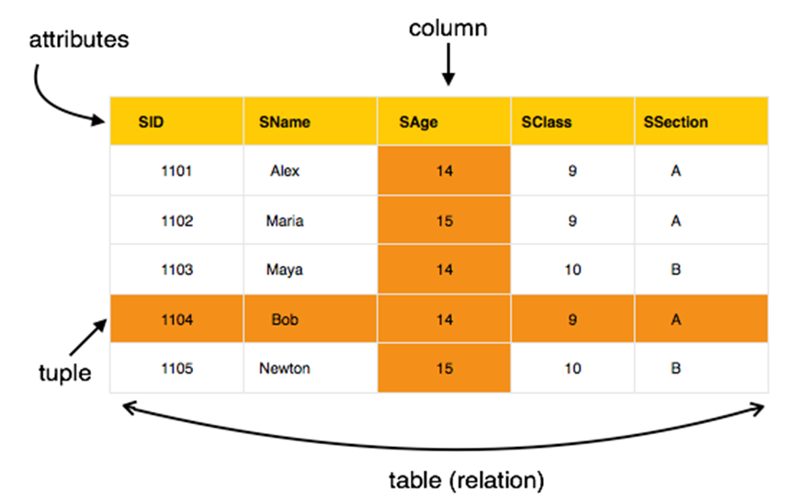
Contents of a table

Slide 29
SQL
What is SQL?
Structured Query Language or SQL is a standard Database language which is used to create, maintain and retrieve the data from relational databases like MySQL, Oracle, SQL Server, PostGreSQL, etc.
It is used when we have structured data (in the form of tables).
All databases that are not relational (or do not use fixed structure tables to store data) and therefore do not use SQL, are called NoSQL databases. Examples of NoSQL are MongoDB, DynamoDB, Cassandra, etc

Slide 30
SQL is a tool for organizing, managing, and retrieving data stored by a computer database.
SQL is a computer language that you use to interact with a database
SQL works with one specific type of database, called a relational database, which has become the mainstream way to organize data across a very broad range of computer applications.

Slide 31
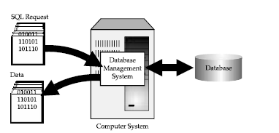
Figure shows how SQL works. The computer system in the figure has a database that stores important information. If the computer system is in a business, the database might store inventory, production, sales, or payroll data. The computer program that controls the database is called a database management system (DBMS).
When you need to retrieve data from a database, you use the SQL to make the request.
The DBMS processes the SQL request, retrieves the requested data, and returns it to you.
This process of requesting data from a database and receiving the results is called a database query—hence the name Structured Query Language

Slide 32
